Slide 1
Computational Thermal Engineering
GROUP Project - 2 : Flow over a sphere
DAY 13
Kumaresh Selvakumar

Slide 2
Group Project
Create a surface file “Sphere”
Create a case setup file for the problem, “Flow over a sphere”
Modify the case setup file
Run your new case file
Upload your new solver, case files, and results in GITHUB

Slide 3
1. Create a surface file “Sphere”
1) Use any modelling software (AutoCAD, CATIA, FreeCAD or any tool) to model sphere
2) Sphere dimensions are as follows:
Radius = 0.1mm
Location of the sphere = (0.5mm, 0.5mm, 0.5mm)
3) Export the sphere file with the file name, “sphere.obj”

Slide 4
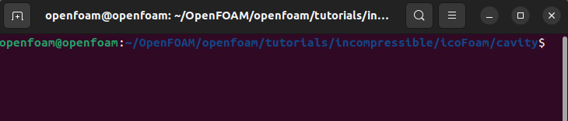
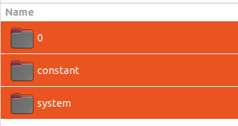

2. Create a case setup file for the problem, “Flow over a sphere”
Use icoFoam solver
From the location:
Copy 0, constant, and system files in the new file name
“flowOverSphere_YourNAME”

Slide 5
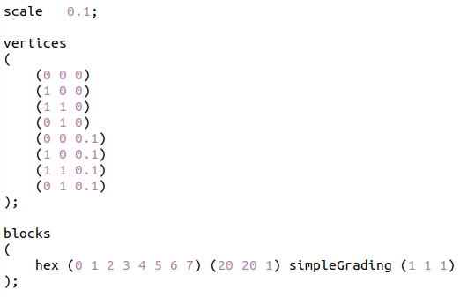
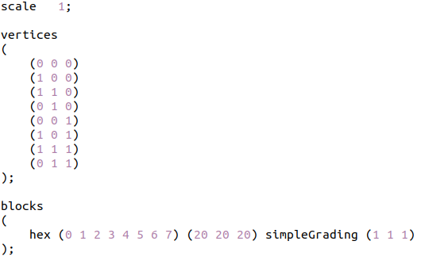
3a. Modify the case setup file
Changes in system/blockMesh file
icoFoam file
flowOverSphere

Slide 6
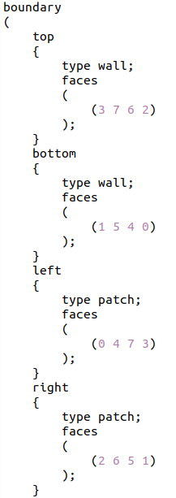
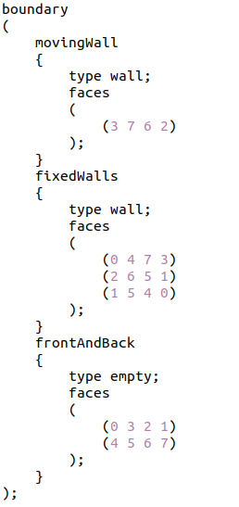
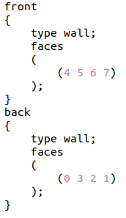
3a. Modify the case setup file
Changes in system/blockMesh file
icoFoam file
flowOverSphere

Slide 7
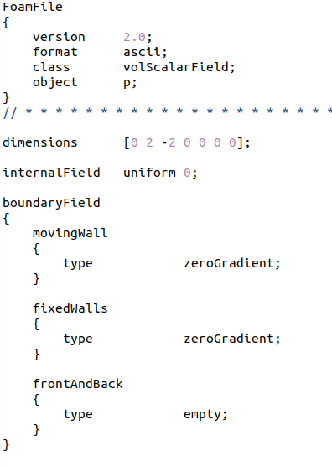
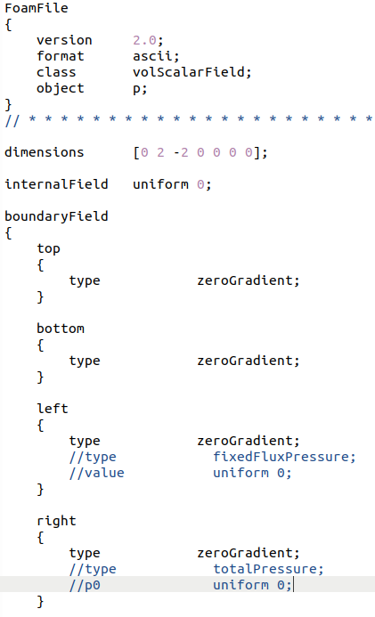
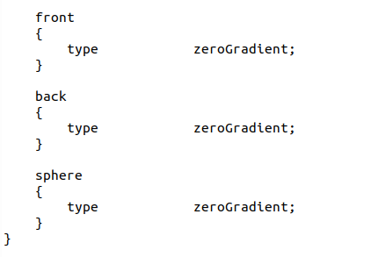
3b. Modify the case setup file
Changes in 0/p boundary file
icoFoam file
flowOverSphere

Slide 8
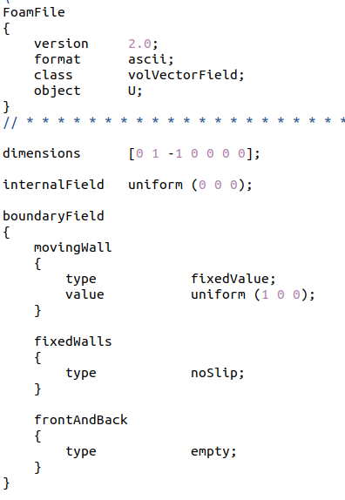
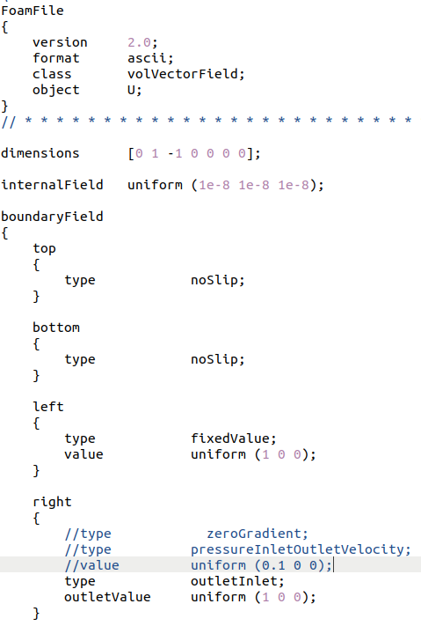
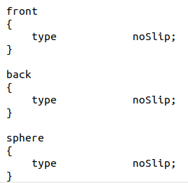
3b. Modify the case setup file
Changes in 0/U boundary file
icoFoam file
flowOverSphere

Slide 9

3c. Modify the case setup file
Changes in constant file
1) Create a triSurface file by the following command:
mkdir –p triSurface
2) Inside the triSurface file, copy the surface file named “sphere.obj” (Carried out in step 1)

Slide 10
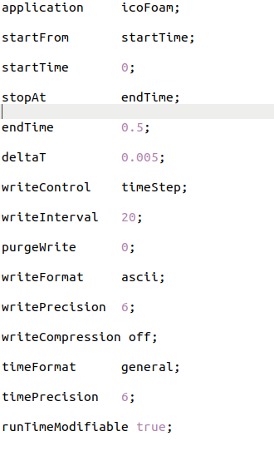
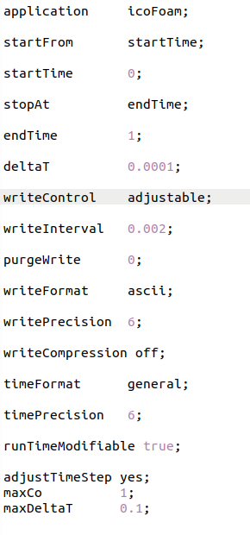
3d. Modify the case setup file
Changes in system/controlDict file
icoFoam file
flowOverSphere

Slide 11
3d. Modify the case setup file
Changes in system file
1) Keep the remaining files, fvSchemes, fvSolution, and decomposeParDict as such.
2) Download the following files from GitHub and copy inside system file:
> meshQualityDict
> snappyHexMeshDict
> surfaceFeatureExtractDict

Slide 12
4. Run your new case file
blockMesh
surfaceFeatureExtract
snappyHexMesh -overwrite
icoFoam

Slide 13
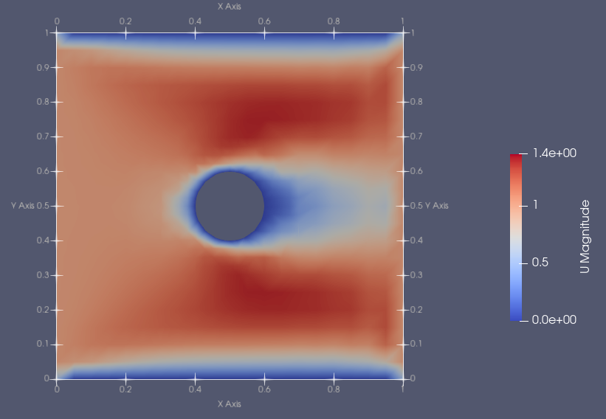
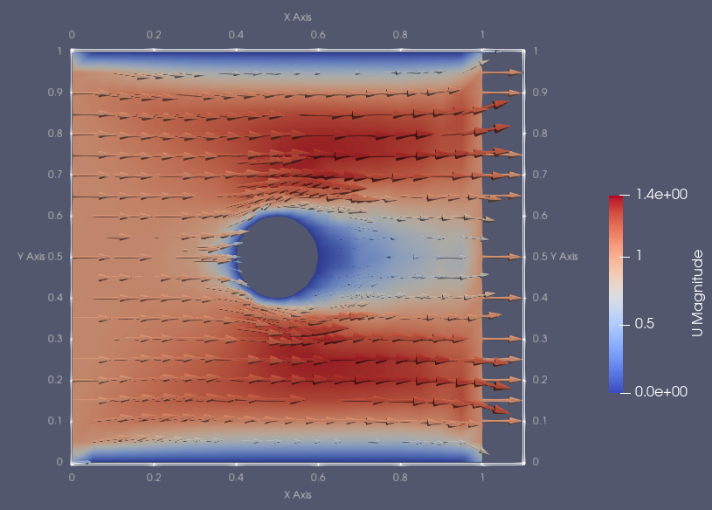
5. Upload your new solver, case files, and results in GITHUB

